Slide 1
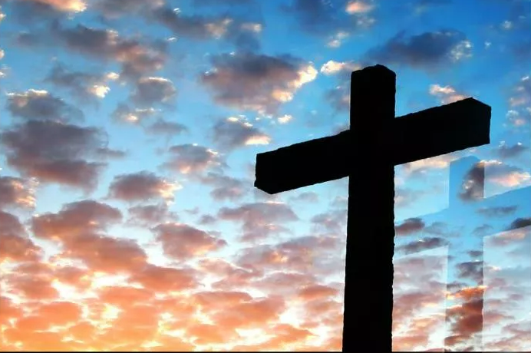
What is the Work of the Church
According to the Church of Christ?
Ephesians 4:12-16
Notes:
Eddie Williams ~ September 20,2026

Slide 2
According to the churches of Christ, the collective work and mission of the church is strictly defined by the New Testament pattern and is traditionally divided into three primary areas:
Evangelism
Edification
Benevolence

Slide 3
1) Evangelism (Preaching the Gospel) Spreading the Message:
The primary outward mission of the church is to proclaim the Gospel of Jesus Christ to a lost world. Fulfilling the Great Commission.

Slide 4
Congregations and members view teaching non-believers and inviting them to salvation and baptism as a core responsibility commanded by Christ in Matthew 28:19–20.

Slide 5
Edification (Building Up Believers) Strengthening Members:
The inward focus of the church is to spiritually nourish, teach, and encourage its own members so they can grow in faith and resist sin.

Slide 6
Spiritual Growth: This is accomplished through collective worship, studying the Bible together, praying, and supporting one another in Christian love (Ephesians 4:11–16).

Slide 7
Benevolence (Relieving the Needy) Caring for Saints:
Financial and material aid from the church treasury is scripturally designated to assist needy fellow Christians (saints) who are facing distress or affliction.

Slide 8
While individual Christians are encouraged to do good for all people as they have opportunity, the organized institutional work of church relief is carefully kept within these biblical boundaries (Galatians 6:10).

Slide 9
Key Boundaries and Authority;
No Social or Recreational Agenda

Slide 10
Churches of Christ emphasize that the church treasury and institutional authority should not be used for secular education, general community entertainment, sports, or commercial fundraising suppers, viewing those activities as outside divine scriptural authority.

Slide 11
Strict Biblical Pattern:
Everything the church does must be authorized by New Testament commands, examples, or necessary inferences ("doing things by the authority or in the name of Christ").

Slide 12
A Deeper Look at Edification

Slide 13
Ephesians 4:12-16 (NLT)
¹² Their responsibility is to equip God's people to do his work and build up the church, the body of Christ. ¹³ This will continue until we all come to such unity in our faith and knowledge of God's Son that we will be mature in the Lord,

Slide 14
Ephesians 4:12-16 (NLT)
measuring up to the full and complete standard of Christ. ¹⁴ Then we will no longer be immature like children. We won't be tossed and blown about by every wind of new teaching. We will not be influenced when people try to trick us with lies so clever they sound like the truth.

Slide 15
Ephesians 4:12-16 (NLT)
¹⁵ Instead, we will speak the truth in love, growing in every way more and more like Christ, who is the head of his body, the church.
¹⁶ He makes the whole body fit together perfectly.

Slide 16
Ephesians 4:12-16 (NLT)
As each part does its own special work, it helps the other parts grow, so that the whole body is healthy and growing and full of love.

Slide 17
“Equipping the saints” means that church leaders train, prepare, and empower everyday believers to do the work of ministry and serve others.

Slide 18
This phrase comes from the Bible in the book of Ephesians, specifically Ephesians 4:11-12. In these verses, the apostle Paul writes that God gives leaders—such as pastors, teachers, and evangelists—to the church for a specific purpose: preparing the people of God for works of service.

Slide 19
Key Ideas Behind the Phrase
“Who are the Saints?"

Slide 20
In the New Testament, "saints" does not mean special, super-religious people or historical figures.
It refers to every single Christian believer.

Slide 21
What does "equip" mean?
The original Greek word used in the Bible is “katartizo.” It means to mend, fully furnish, prepare, or make complete. It is similar to a coach training a sports team with the right tools and practice so they are ready to play.

Slide 22
Shifting the Workload:
Instead of the pastors, preachers and teachers doing 100% of the work, visiting the sick, and teaching all classes alone, the leader's job is to unlock and develop the spiritual gifts of the entire congregation.

Slide 23
Providing Opportunities to Serve: Helping individuals discover their unique spiritual gifts and putting them into practice within the community. The ultimate goal of equipping is to build up the body of Christ (the local church). When every believer uses their unique abilities, the church grows into spiritual maturity, stays unified, and makes a positive impact on the world.

Slide 24
Avenues to Use for Equipping the Saints: Gospel meetings, lectureships, workshops, Bible Bowls, and such, focused on a greater understanding of GOD’S word and who He is.

Slide 25
Ephesians 4:12-16 (NASB)
¹² for the equipping of the saints for the work of service, to the building up of the body of Christ; ¹³ until we all attain to the unity of the faith, and of the knowledge of the Son of God, to a mature man, to the measure of the stature which belongs to the fullness of Christ.

Slide 26
Ephesians 4:12-16 (NASB)
¹⁴ As a result, we are no longer to be children, tossed here and there by waves and carried about by every wind of doctrine, by the trickery of men, by craftiness in deceitful scheming; ¹⁵ but speaking the truth in love, we are to grow up in all aspects into Him who is the head, even Christ,

Slide 27
Ephesians 4:12-16 (NASB)
¹⁶ from whom the whole body, being fitted and held together by what every joint supplies, according to the proper working of each individual part, causes the growth of the body for the building up of itself in love.

Slide 28
John 17:3 (AMPC)
And this is eternal life: [it means] to know (to perceive, recognize, become acquainted with, and understand) You, the only true and real God, and [likewise] to know Him, Jesus [as the] Christ (the Anointed One, the Messiah), Whom You have sent.

Slide 29
Scripture 1 (version)
Trebuchet MS (Body)
Minimum size = 54
Transition beginning of scripture = Doors
Transition subsequent pages = Page Curl

Slide 30
Scripture 2 (version)
Trebuchet MS (Body)
Minimum size = 54
Transition beginning of scripture = Doors
Transition subsequent pages = Page Curl

Slide 31
Scripture 2 (version)
Trebuchet MS (Body)
Minimum size = 54
Transition beginning of scripture = Doors
Transition subsequent pages = Page Curl

Slide 32
Point #2: Point title
Scripture (version)
Scripture (version)

Slide 33
Scripture 1 (version)
Trebuchet MS (Body)
Minimum size = 54
Transition beginning of scripture = Doors
Transition subsequent pages = Page Curl

Slide 34
Scripture 1 (version)
Trebuchet MS (Body)
Minimum size = 54
Transition beginning of scripture = Doors
Transition subsequent pages = Page Curl

Slide 35
Scripture 2 (version)
Trebuchet MS (Body)
Minimum size = 54
Transition beginning of scripture = Doors
Transition subsequent pages = Page Curl

Slide 36
Scripture 2 (version)
Trebuchet MS (Body)
Minimum size = 54
Transition beginning of scripture = Doors
Transition subsequent pages = Page Curl

Slide 37
Point #3: Point title
Scripture (version)
Scripture (version)

Slide 38
Scripture 1 (version)
Trebuchet MS (Body)
Minimum size = 54
Transition beginning of scripture = Doors
Transition subsequent pages = Page Curl

Slide 39
Scripture 2 (version)
Trebuchet MS (Body)
Minimum size = 54
Transition beginning of scripture = Doors
Transition subsequent pages = Page Curl

Slide 40
Scripture 2 (version)
Trebuchet MS (Body)
Minimum size = 54
Transition beginning of scripture = Doors
Transition subsequent pages = Page Curl

Slide 41
Point #4: Point title
Scripture (version)
Scripture (version)

Slide 42
Scripture 1 (version)
Trebuchet MS (Body)
Minimum size = 54
Transition beginning of scripture = Doors
Transition subsequent pages = Page Curl

Slide 43
Scripture 2 (version)
Trebuchet MS (Body)
Minimum size = 54
Transition beginning of scripture = Doors
Transition subsequent pages = Page Curl

Slide 44
Scripture 2 (version)
Trebuchet MS (Body)
Minimum size = 54
Transition beginning of scripture = Doors
Transition subsequent pages = Page Curl

Slide 45
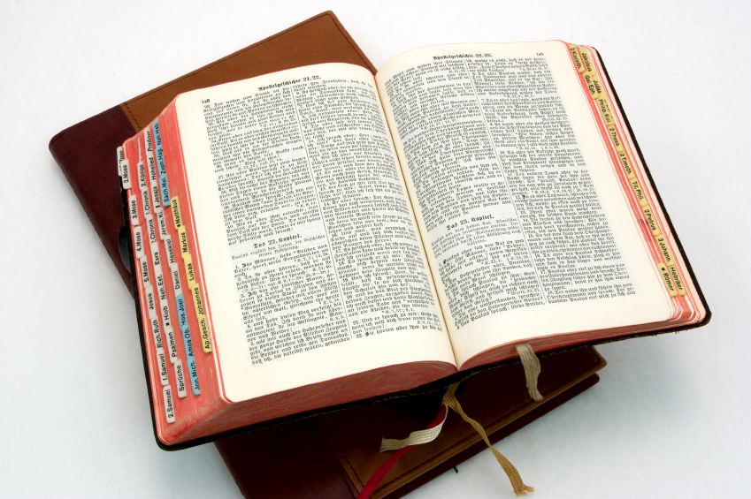
Hear: Romans 10:17
So then faith cometh by hearing, and hearing by the word of God.

Slide 46
Believe: Hebrews 11:6
But without faith it is impossible to please him: for he that cometh to God must believe that he is, and that he is a rewarder of them that diligently seek him.

Slide 47
Repent: Luke 13:3
I tell you, Nay: but, except ye repent, ye shall all likewise perish.

Slide 48
Confess: Matthew 10:32-33
32 Whosoever therefore shall confess me before men, him will I confess also before my Father which is in heaven.
33 But whosoever shall deny me before men, him will I also deny before my Father which is in heaven.

Slide 49
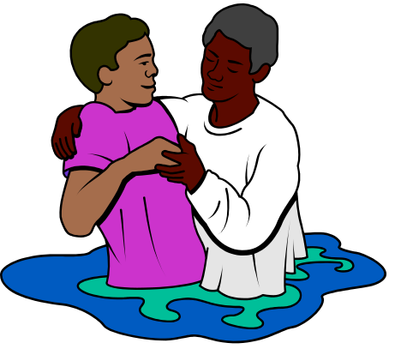
Baptize: Acts 22:16
And now why tarriest thou? arise, and be baptized, and wash away thy sins, calling on the name of the Lord.

